Slide 1
Anesthesia for ent and maxillofacial surgery
Leulayehu akalu (Ass.Professor )

Slide 2
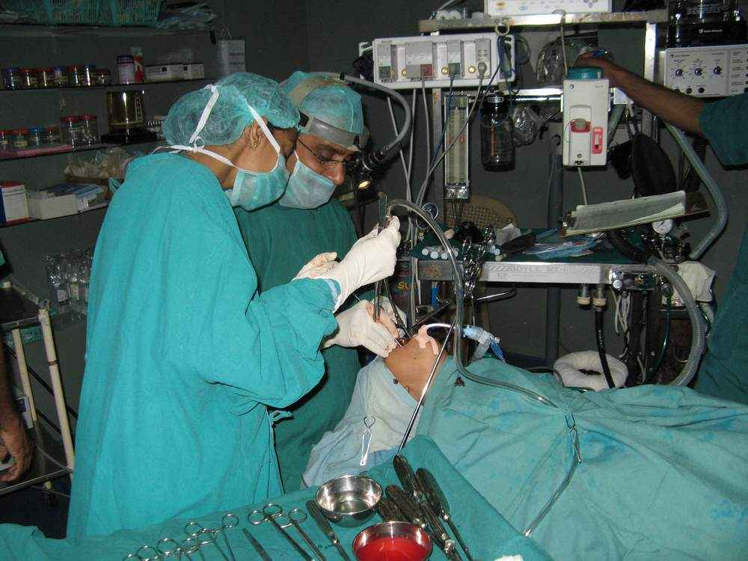
Anesthesia for ent and maxillofacial surgery

Slide 3
Objective
Provide safe anesthesia for ENT and Maxillofacial surgeries .

Slide 4
Contents
1.Unique challenges of ENT anesthesia for anesthetists
2.Physiologic anatomy of the ear
3.Craniofacial abnormalities
Cleft lip and palate

Slide 5
Mandibular hypoplasia
Hypertelorism
4.Anesthesia for sinus surgery

Slide 6
5. Radical neck dissections
6.Upper respiratory tract obstructions
7.Anesthesia for tonsillectomy patients (Including OSA)
8.Foriegn body aspirations and removal
9.Maxillo facial injury
10.Summary

Slide 7
Unique challenges of ent anesthesia to anesthetists
Difficult air ways (impossible to intubate)
Shared air way
Head movement is the norm
Use of laser technology
Use of microscope

Slide 8
Challenges
The pathology by it self such as (Ludwig’s angina, retropharyngeal, parapharyngeal abscess), acute onset of stridor, epiglottitis, laryngotracheobronchitis, inhaled foreign bodies, facial injuries, etc. are a challenge to both the surgeon and the anesthetist and communication and cooperation is vital.

Slide 9
Challenges
Congenital anomalies
Post operative air way obstruction
Good post operative analgesia
Minimal or restricted use of muscle relaxant
Presence of cancer or Tumor in the upper airway

Slide 10
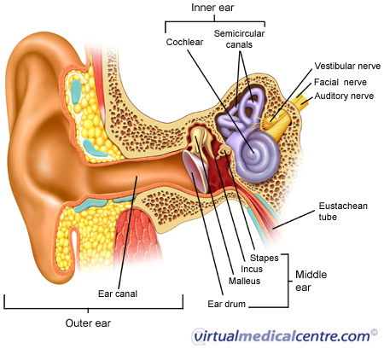
Physiologic anatomy of the ear

Slide 11
Neuronal supply to ear
Facial Nerve
Vestibular Nerve
Auditory Nerve

Slide 12
Openings in the ear
External acoustic meatus
Fenestra ovalis
Fenestra rotunda
Eustachian tube
INNER EAR
Vestibule
Cochlea
Semicircular canals

Slide 13
Vestibule
Utricle and Sacule
Macula –produces sense of position of head
Sensation of pull of gravity
Sensation of acceleration
Righting reflexes'

Slide 14
Cochlea
The most mechanically complex structure
Hearing organ located here
Organ of Corti

Slide 15
Semicircular canals
Responsible for head movement

Slide 16
Important structures
In the utricle-macula end organ of sensation of head position
In the semicircular canals- crista ampularis end organ of sensation of head movement
In the cochlear duct –organ of corti end organ of hearing

Slide 17
Hearing
Air –external auditory meatus
Bone –three ossicles
Fluid (per lymph then to endo lymph)
Hearing results from Stimulation of the Auditory area of cerebral cortex in temporal lobe.

Slide 18
Tracheostomy
Definition :A tracheostomy is a surgical procedure wherein a tube is placed in the windpipe while bypassing the nose, mouth and throat. This tube may be placed temporarily or permanently.

Slide 19
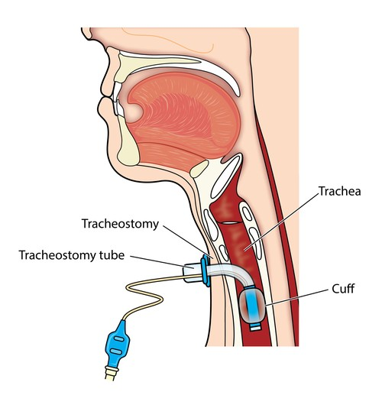
Tracheostomy

Slide 20
Tracheostomy
Tracheotomy is done when the usual way of breathing is blocked or reduced. A tracheostomy is often needed when health problems require long-term use of a ventilator to help with breathing.
A tracheostomy allows air to pass into the windpipe to help with breathing.

Slide 21
Indications for tracheostomy
Patient population
Rarely failed intubation cases in respiratory distress
Following major trauma or in respiratory failure
Part of scheduled procedure in neck dissection

Slide 22
Elective tracheostomy is indicated in patients with prolonged mechanical ventilation, anticipated airway obstruction due to extensive head and neck surgery or edema (eg, from cancer, trauma, or radiation), obstructive sleep apnea refractory to other therapies, recurrent aspiration from impaired airway protection

Slide 23
Precautions
A clean tracheostomy site, good tracheostomy tube care and regular examination of the airway by an otolaryngologist should minimize the chances of complications.

Slide 24
Tracheostomy care
Clean, replace, and suction the tube.
Keep the air moist.
Clean the hole with water and mild soap or hydrogen peroxide.
Change the dressing around the hole

Slide 25
Craniofacial abnormalities
Cleft lip and palate
Mandibular hypoplasia
Hypertelorism

Slide 26
Cleft lip and palate
The third most common congenital anomaly which requires surgery
50% cleft lip and palate
33%cleft palate
14% -17%cleft lip

Slide 27
Cleft lip and cleft palate are openings or splits in the upper lip, the roof of the mouth (palate) or both. Cleft lip and cleft palate result when facial structures that are developing in an unborn baby don't close completely.
Cleft lip and cleft palate are among the most congenital anomalies .

Slide 28
Sign and symptoms
Difficulty with feedings
Difficulty swallowing, with potential for liquids or foods to come out the nose
Nasal speaking voice
Chronic ear infections

Slide 29
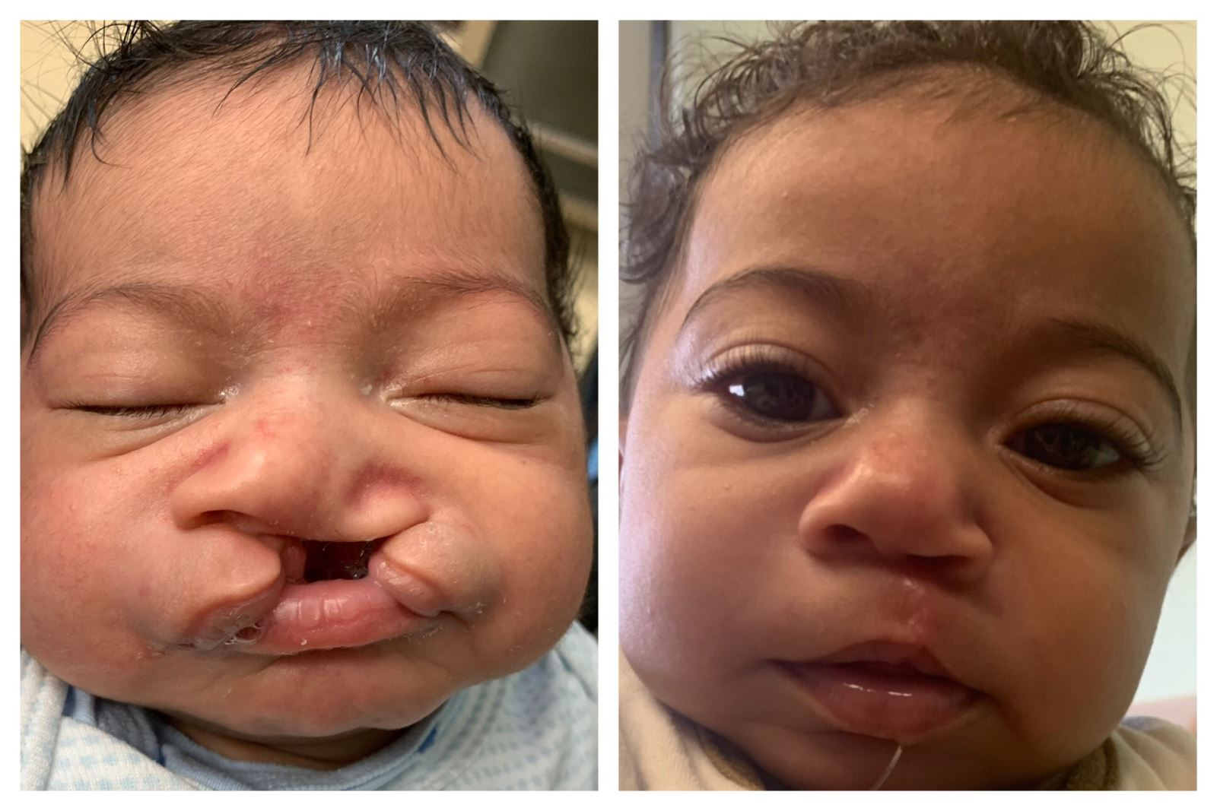

Slide 30
Associated problems
Facial disfiguration
Social isolation
Problem during deglutition
Abnormal speech
Increased incidence of URTI
Congenital heart disease

Slide 31
Types of surgery
Cheiloplasty
Palatoplasty
Anesthetic considerations
Difficult intubation
Inadvertent extubation
Post operation air way obstruction

Slide 32
Preoperative evaluation
Associated congenital anomalies(congenital heart disease>150 anomalies)
Chronic rhinorrea
OSA
Left ventricular hyper trophy

Slide 33
Anesthesia
Inhalational induction
Insertion of gauze in cavernous defect
Tape tube to lower lip
Use rae tube

Slide 34
Suture tongue to mid line
Consider epineprine
If air way edema extubate after 48-72hours

Slide 35
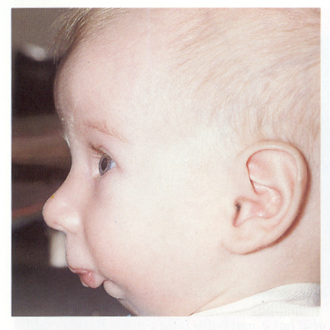
Mandibular hypoplasia

Slide 36
Pier robin syndrome
Cleft palate
Small jaw
gloss ptosis

Slide 37
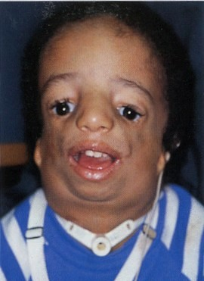
Treacher Collins syndrome

Slide 38
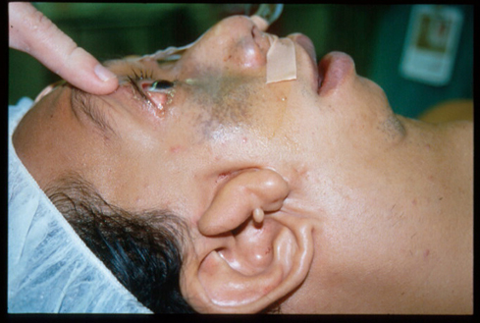
Goldenhar syndrome

Slide 39
Common feature of the three syndromes
Small mandible leaves little room to displace the tongue
Upper air way obstruction
Difficult intubation

Slide 40
Anesthetic management
Anticholinergics
Avoid opoids
ASpiration propylaxis
Prepare for difficlt intubation (FOL,awake intubation)
Inhalational induction
Use of LMA
Extubate when fully awake

Slide 41
Hypertelorism
an abnormally enlarged interpupillary distance, and results in increased distance between the orbits. Primary hypertelorism results from under migration of the paired nasal swellings, which results in an increased distance between the two halves of the face.

Slide 42
Causes
Genetics
Life style choice
Medications
Infection
Combinations of many factors

Slide 43
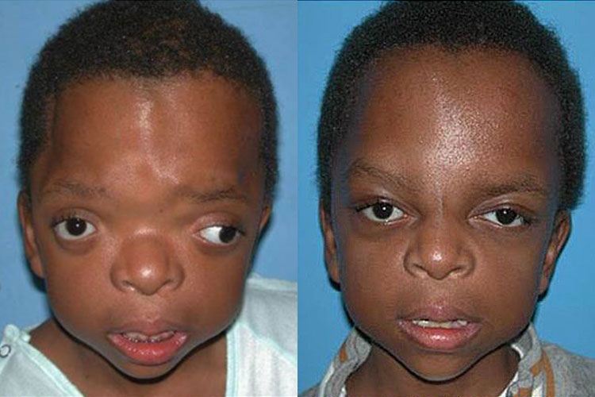

Slide 44
Anesthesia for hypertelorism
Qualified operation team
Difficult intubation Vs elective tracheostomy
Excess blood loss
Hypothermia
Intracranial hypertension
Invasive monitoring
Post operation ventilation of lungs

Slide 45
Interdisiciplinary cooperation
Predict difficult air way
Tube dislogement
Quantification of blood loss
Controlled hypotension
Hypothermia

Slide 46
Avoid neuronal palsy
Hyperventilation
Head position
Lasix

Slide 47
Mannitol
Sterids
Limit 5%DW
Thiopentone

Slide 48
Oculo cardiac reflex
Wire cutter

Slide 49
Ludwig's angina
Ludwig’s angina is a severe diffuse cellulitis which spreads rapidly and becomes a potentially life-threatening condition due to the risk of impending airway obstruction
It is considered as emergency because edema, distortion, and obstruction of the airway. Hence, early diagnosis, securing airway and treatment of Ludwig’s angina is exceptionally important.

Slide 50
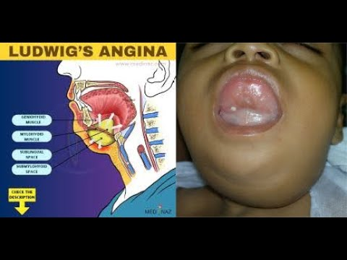

Slide 51
Ludwig’s angina was first described in 1836 by Wilhelm Friedrich von Ludwig and angina implies the suffocating sensation. It is characterized as a rapidly progressive gangrenous cellulitis of the soft tissues of the neck and floor of the mouth. Primary cause is related to gingival or dental disease infections of the second and third molars. Other causes include per tonsillar and parapharyngeal abscess, oral laceration, otitis media

Slide 52
Clinical presentation
a history of recent dental procedures and neck swelling. Less common complaints include neck pain, dysphonia, dysphagia, and dysarthria. Less than one third of adults will present in respiratory distress with dyspnea, tachypnea, or stridor. On physical examination, over 95% of patients have bilateral submandibular swelling and an elevated or protruding tongue.

Slide 53
three elements for definitive diagnosis
1.Cellulitis of the submandibular (composed of sublingual and sub mylohyoid) space.
2.A bilateral infection
3.Aggressive or rapidly spreading

Slide 54
Management
Airway control, antibacterial therapy and incision and drainage are the main stay of initial treatment Airway management is the foundation of treatment for patients with Ludwig’s angina. Antibiotics should be initiated as soon as possible.

Slide 55
Anesthetic implications
Anesthesia Implications Patients with Ludwig’s angina often present with trismus due irritation of masticatory muscle, dyspnea, tachypnea, inspiratory stridor and cyanosis are signs of impending airway obstruction. The decision to secure the airway continues to rely on clinical judgment, review of diagnostic and imaging studies surgical plan and skill and experience.

Slide 56
Stridor
Stridor is a harsh, noisy, vibratory high-pitched, predominantly inspiratory sound produced due to upper airway obstruction resulting in turbulent airflow in the respiratory passages. It is symptomatic of underlying pathology and may herald life-threatening airway obstruction. This can progress rapidly to complete airway obstruction and death from asphyxiation. Stridor at rest, implies that there is a reduction in airway diameter of at least 50%.

Slide 57
Airway management
Difficult airway management equipment with tracheostomy should be kept ready. Endotracheal intubation is difficult in this patient may precipitate acute airway collapse hence awake fiberoptic intubation is method of choice in establishing the airway and should be first line of management.

Slide 58
Anesthetic plan and management for Ludwig's angina
100% Oxygen in sitting position
Dexamethasone
Nebulized Epineprine 1mg in 1000 solution (1ml in 5ml 0.9% saline )
Avoid Blind Nasal intubation
Avoid direct Orotracheal intubation
awake fiberoptic intubation if fails
Surgical tracheostomy is performed under local anesthesia.

Slide 59
Anesthesia for sinus surgery
Sinusitis is an Inflammation of the sinus The sinuses are a system of cavities located both inside and outside the skull. Sinuses can produce symptoms, including facial pain and nasal congestion when irritated.

Slide 60
Treatment
1.Medical (Antibiotics ,Nasal Decongestants, including Antihistamines )
Surgical
2.Endoscopic Sinus Surgery (ESS):

Slide 61
Endoscopic Sinus Surgery (ESS): is a minimally invasive surgical procedure used to remove sinus blockage and establish wide sinus drainage pathways.
It is performed entirely through the nostrils. This procedure is typically reserved for patients who have severe sinus disease that cannot be controlled with medications or less invasive techniques.

Slide 62
ESS is a surgical solution for several sinus issues. ESS is most frequently used to treat chronic sinusitis. However, it can also treat other disorders like tumors and polyps. May also be used to treat difficult cases of acute sinusitis.

Slide 63
Types of nasal and sinus surgery
Functional endoscopic sinus surgery (FESS). In FESS, a surgeon inserts an endoscope equipped with a camera and light into the nose and guides it to the sinuses. ...
Septoplasty. ...
Turbinate surgery. ...
Balloon sinus dilation. ...
Adenoidectomy.

Slide 64
Surgical approaches
Nasal Endoscopy
CT Scan (Computerized Tomography)

Slide 65
Sign symptoms and indications
Face pressure or pain
Headache
Foul-smelling nasal discharge
Nasal obstruction
If these symptoms persist for 10-12 days without improvement or worsen within ten days, endoscopic sinus surgery may be necessary to treat the underlying condition.

Slide 66
Anesthesia for sinus surgery
Anesthetic considerations include the provision of deep anesthesia to prevent reflex induced hypertension and tachycardia, adequate airway protection and the avoidance of bucking, coughing and straining. Emergence may present problems with acute bleeding, stridor and laryngeal spasm.

Slide 67
Major complications of sinus surgery
1.Excessive Bleeding
2.Orbital involvement is the most common complication of sinusitis (accounting for 80% of all complications) because of its close anatomical relationship to the paranasal sinuses.
3. Post Surgery Infection

Slide 68
Radical neck dissections
Procedure : All the tissue on the side of the neck from the jawbone to the collarbone is removed. The muscle, nerve, salivary gland, and major blood vessel in this area are all removed. Modified radical neck dissection

Slide 69
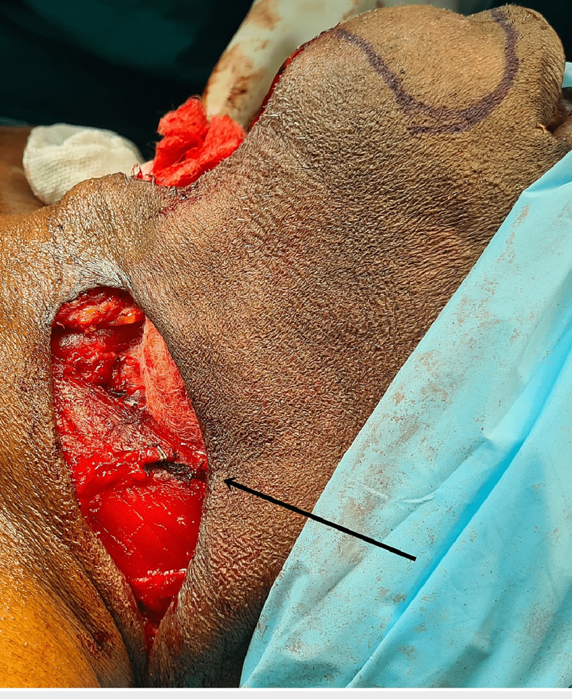
Radical neck dissections

Slide 70
Three types of modified radical neck dissection
Type I :which spares one structure, most commonly the spinal accessory nerve
type II :which spares two structures, most commonly the spinal accessory nerve and the internal jugular vein
type III :spares all three structures—the spinal accessory nerve, internal jugular vein and sternomastiod muscle .

Slide 71
Anesthetic considerations
Disstortion of normal anatomy of the air way
Preoperative X-ray of the upper respiratory tract
Meticulous cooperation by the surgeon
Awake intubation choices

Slide 72
Surgical and anesthetic risks
Risks for anesthesia and surgery in general are:
Allergic reactions to medicines
Breathing problems
Bleeding
Infection

Slide 73
Limited neck movement
Drooping shoulder on the side of the surgery
Problems talking or swallowing
Facial droop

Slide 74
Expected intraoperative complications
1.ETT damage
2.Vagal stimulation
Recognition-decreased B/P &heart rate

Slide 75
Management
Stop stimulation
Atropine
Lidocaine
Prepare for CPR

Slide 76
3.Hypoxia
Cause –Hematoma compression
S/S- agitation increased Paco2&HR decreasedPao2
Treatment — Release neck dressing and remove hematoma
ETT and ventilate with 100%oxygen

Slide 77
4.Pneumotorax
S/S-RR and CVP increased B/P decreased
Wheezing /decreased oxygen saturation/chest pain decreased breath sound and ECG amplitude
Management –chest tube /needle aspiration /oxygen /ventilation /volume expansion

Slide 78
Acute upper airway disorders
Acute upper air way obstructions
Epiglottitis
Laryngo trachoebronchitis
Foreign body aspirations

Slide 79
Epiglottitis
Acute epiglottitis :is an acute inflammation of the epiglottis, arytenoids, and aryepiglottic folds with rapid onset
and progression leading to complete airway obstruction,
hypoxemia and death

Slide 80
Epiglottitis
Epiglottitis is characterized by the abrupt onset of severe symptoms. Without airway control and medical management, symptoms may rapidly progress to respiratory obstruction and death in a matter of hours.

Slide 81
Clinical symptoms
The clinical triad of drooling, dysphagia, and distress is the classic presentation. Fever with associated respiratory distress or air hunger occurs in most patients. Drooling occurs in up to 80% of cases with high fever

Slide 82
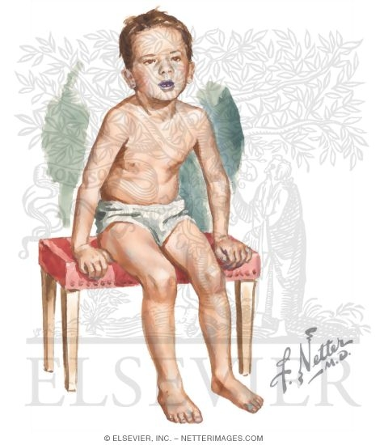
Triploid position epiglottitis

Slide 83
X-ray findings
If an X-ray can be done, ‘thumbprint sign’ (tissue
swelling around hyoid bone) and the ‘vallecula’ sign (at
the tongue base) are diagnostic of epiglottitis.

Slide 84
Expected problems of epiglottitis
Hypoxemia
Full stomach
Intubation difficulty
Preventable death
Permanent artificial airway

Slide 85
Anatomic and functional vulnerability of pediatric airway
Minor amount of swelling or compression will have a dramatic effect on the airway it will :
1-Reduce cross sectional area.
2-Increase the resistance .

Slide 86
Sign and symptoms of upper airway obstructions
1-Pattern of breathing (will revel the degree of urgency and level of obstruction)
2-agitation /restless /letargy
3-Hypoxemia
4- hyper carbia

Slide 87
Epiglottitis
Affects loose submucosae tissue
Lingual surface
Laryngeal surface
Paraglottis

Slide 88
Incidence 5%of children with stridor
Affected age 2-6yrs
Cause H.influenza(isolated from swab and blood with sudden onset )
Extra thoracic upper airway obstruction

Slide 89
Fundamental goals
Prepare for respiratory arrest and mobilize operation room team
Donot disturb the child(Not allow the child to cry )
Lateral neck x.ray (thumb like blurred rounded epiglottis )

Slide 90
Safely transport the child to operation room
Perform inhalational induction
Be ready for cricothyrotomy or tracheostomy

Slide 91
Post operative management
Evaluate leake around the tube (20-30CmH2o)
Prevent self and accidental extubation
Consider fluid status of the child
Antibiotics

Slide 92
Transfer to ICU
Monitor ETCo2
CPAP
Extubate when edema subsides(48-96

Slide 93
Tracheolaryngo bronchitis
Incidence 80%of children with upper air way obstruction(age <2yrs etiology viral)
Subglottic larynx is affected
S.S
Retraction barking cough/
Stridor
hoarseness

Slide 94
Clinical croup score
Breathing sounds | Normal 0 | Hoarse with Rhonchi 1 | Delayed 2
Stridor | None 0 | Inspiratory 1 | Inspiratory &expiratory 2
cough | None 0 | Hoarse cry 1 | Barking 2
Cyanosis | None 0 | In the air 1 | 40%oxygen 2
Retractions and flaring | None 0 | Flaring suprasternal 1 | Flaring suprasternal intercostal 2

Slide 95
Croup score >or =4 Racemic epinephrine is indicated as a local vasso constrictor
Croup score >or =7
Ventilate
Inhalational induction
ETT or
tracheostomy

Slide 96
Anesthetic management for epiglottitis and tracheolargo bronchitis(Summary
IV line
Glycopylorate3-5ug/kg
Volatile induction in a sitting position
Then supine position
When in deep plane intubate nasally
Post operation keep tube 48-96hrs

Slide 97
Extubation
Normal body temperature
Decreased neutrophil and lymphocyte count
Air leak around endotracheal tube
Confirm resolving of edema
48-96hrs

Slide 98
Anesthesia for endoscopy and bronchoscopy
Indications
Diagnostic
Therapeutic

Slide 99
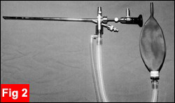
Bronchoscope

Slide 100
Special considerations
Existing airway problem
Difficult to maintain ventilation
Possibility of complete airway obstruction
Post operative reduction in airway lumen

Slide 101
Anesthetic management
Asses respiratory status
No heavy sedation or narcotics
Atropine to all

Slide 102
Inhalational induction
Lidocaine spray
When deep enough bronchoscope can be inserted
Supply oxygen and inhalational agent to the side arm

Slide 103
Assist ventilation
Monitor ventilation and heart rate
Two stethoscopes
Check for pneumothorax

Slide 104
Expected events
Hypoventilation(high fresh gas flow criciod pressure)
High resistance to gas flow(intermitant removal of the optics)
Endobronchial placement of the bronchoscope (withdraw to trachea)

Slide 105
Complications of Bronchoscopy
Brady cardia(hypoxemia)
Arterial hypoxemia or hyper carbia (airway obstruction)
PVC
Pneumothorax
Fragmentation of foreign body
Subglottic edema

Slide 106
Management of complications
Subglottic oedema –inhalation of aerosolized epineprine
Dexamethasone as prophylaxis
CXR(atlectiasis pneumothorax)
Chest drainage
Avoid coughing with bronchoscope in place

Slide 107
Foreign body aspiration
Sudden onset of respiratory distress with coughing, gagging, stridor, or wheezing in the absence of fever suggests Foreign body aspiration .
Key to successful outcome is early recognition as signs are obvious but often fatal if undiagnosed and untreated

Slide 108
Problems
Complete obstruction of the airway
Residual pulmonary disease /infection
Asphyxiation
death

Slide 109
Sign and symptoms
Cough
Wheezing
Decreased air entry on the affected side

Slide 110
Diagnosis and treatment
History
Radiographic
Blood gas analysis
Treatment
Endoscopic removal

Slide 111
Anesthetic management
As Stated for bronchoscopy

Slide 112
Otology procedures
Cochlear implant: Placement of a multichannel electrode in the Scala tympani through the medial wall of the middle ear. Used in patients with severe and profound sensorineural hearing loss. It partially replaces the function of cochlea transforming sound energy into electrical signals

Slide 113
Myringoplasty: Isolated repair of the tympanic membrane (also known as a type 1 tympanoplasty). A suitable graft, often temporalis facia, is placed and acts as a scaffold over which new epithelium will grow to repair the hole. Inlay or underlay techniques can be used.

Slide 114
Tympanoplasty: Myringoplasty combined with a repair of chronic middle ear changes to eradicate any chronic infection and restore middle ear function. This can be performed endoscopically.

Slide 115
Stapedectomy
Removal of part of the stapes and placement of a prosthesis to improve hearing.
Stapedotomy
Fenestration of the stapes footplate to improve hearing

Slide 116
Special anesthetic considerations for ear procedures
Repeated operation(psychological problems)
Communication problem
Avoid anesthetic cause of bleeding

Slide 117
Use of vasoconstrictors as bleeding into the operative field can compromise middle ear surgery.
Use of microscopes

Slide 118
Controlled ventilation
Attention to positioning /temperature /padding
Anti emetics: labrynth disturbance

Slide 119
15 degree head up position to minimize bleeding
Adequate fluids
Avoid N2O for tympanoplasty during graft placement
Smooth extubation (lidocaine IV)

Slide 120
Total IV Anaesthesia (TIVA) techniques are frequently used for middle ear surgery and give an enhanced quality of recovery.
Temperature maintenance is easily achieved with a full body forced-air warming device, and mechanical thromboprophylaxis measures should be used.

Slide 121
Venous cannulation should be undertaken at a different site to that selected by the surgeon In some procedures (e.g. stapedectomy), a portion of a superficial vein is taken as a graft.
Induced arterial hypotension .

Slide 122
Laser surgery
Definition :Light amplification by stimulated emission of radiation.
Recent advances in airway,Opthalmic and ENT surgery it is also common for dermatological surgeries .

Slide 123
Types of laser
Lasers are categorised into five main types based on their gain medium, which determines the type of laser needed for different applications. These include Solid-state laser, Liquid-state laser, Gaseous-state laser, Semiconductor laser and Metal Vapour laser

Slide 124
Advantages of laser
Allows highly precise microsurgery
Have the ability to reach the remote site
Allows rapid vaporization of tissue and most other materials except metals /ceramics

Slide 125
It is relatively dry surgery
Seals small blood vessels and lymphatics even in the presence of clotting abnormalities
Used as electro coagulators.

Slide 126
Laser hazards
Damage to normal tissue
Eye injury
The damage is to the patient and health personnel

Slide 127
Hazards
Hazards include both direct beam hazards such as tissue burns, eye damage, endotracheal tube fire, drape fire, and explosion of gases, or non-beam hazards (those that are secondary to the actual beam interaction) such as laser generated airborne contaminants (surgical plume), electrical damage, toxic dyes, and system .

Slide 128
Summary
Each type of laser offers its own set of advantages, disadvantages, and applications, making it important to carefully consider the requirements of a specific application. Solid-state lasers provide high power and precise beam quality, gas lasers offer versatility in wavelength and high power.

Slide 129
Precautions during laser surgery
Tape and close the eye lid (non operated eye)
OR personnel should wear safety goggles(specific to the laser )
All windows in OR should be closed
Everyone in the room must wear protective eyewear and special masks to filter the air they breathe. This safety measure is crucial to protect the eyes from laser damage, and the lungs from any harmful particles.

Slide 130
The first rule of laser safety: Never look directly into any laser beam for any reason.

Slide 131
How to minimize laser fire hazards
Minimum FIO2-o.4
No N2O
Avoid flammable inhalational agents
Use low concentration of volatile agents

Slide 132
Airway fire protocols
Clear communication and emergency practice
Surgeon who detect ETT fire should quickly remove the source and simultaneously should inform the anesthetist
The anesthetist should stop ventilation immediately disconnect breathing circuit from anesthesia machine temporarily
Extubate

Slide 133
Flaming material should be extinguished in bucket of water
Mask ventilation with air
Direct laryngoscopy for damages

Slide 134
Re intubation
If severe damage low tracheostomy
Asses oro pharnyx and face
steroids

Slide 135
Tonsillitis
Tonsillitis is inflammation (swelling) of the tonsils.
It can be caused by viruses or bacteria.
Symptoms include a sore throat, difficult swallowing, fever, headache, and swollen lymph glands.
Tonsillitis is more common in children than in adults

Slide 136
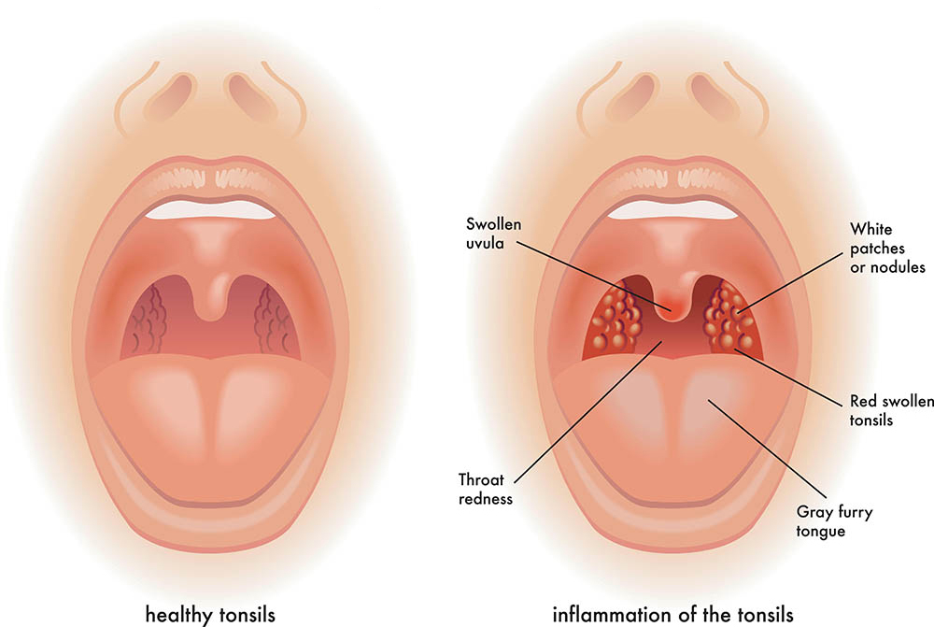
Tonsillitis

Slide 137
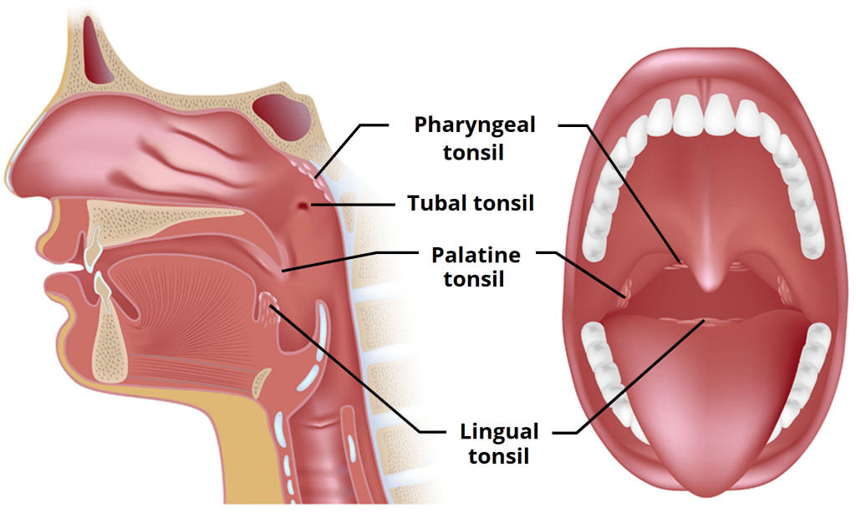
Tonsils

Slide 138
Tonsillectomy and adenectomy
Tonsillectomy is one of the oldest surgical procedures known to man.
Tonsillectomy-Surgical excision of the palatine tonsils.
Purpose
To treat breathing-related sleep disorders, such as OSA
To reduce the risk of infection in people with frequent or chronic tonsillitis.

Slide 139
Three separate pieces of tissues
Lingual
Pharyngeal
Palatine

Slide 140
Blood supply –tonsillar branch of facial artery
Venous drainage –into pharyngeal plexus
Sensory supply –glossopharyngeal nerve

Slide 141
Indications for surgery
Absolute
Upper air way obstruction dysphagia OSA
Peritonsillar abscess/recurrent tonsillitis febrile convulsions
Requirement for biopsy
Relative
Recurrent tonsillitis which is un responsive to treatment

Slide 142
Contraindications for surgery
Bleeding /diathesis(tendency to suffer from medical condition )
Acute infection
Anemia
Significant anesthetic risk

Slide 143
History of URTI(defer surgery)
Rationale----spread of infection
obstruction of ETT
laryngospasm

Slide 144
Obstructive sleep apnea
Partial upper airway obstruction
Intermittent complete obstruction
Neuro developmental delay
Chronic hypoxemia

Slide 145
Pathophysiology of OSA
Decreased lung volume
premature airway closure
alveolar hypoxia
hypoxic pulmonary vasoconstriction
pulmonary hypertension
RV dysfunction

Slide 146
Children's with osa
Obese
Snore at night time
Show day time somnolence
Behavioral problems

Slide 147
Sweat profusely
School failure
Failure to thrive
Developmental delay

Slide 148
Anesthetic considerations for tonsillectomy
Sleep studies
Avoid heavy sedation
Expect post operative apnea
Coagulation profile
History of salicylate ingestion
Intubation difficulty

Slide 149
Post tonsillectomy bleeding
Obstructive sleep apnea due to hypertrophied tonsils

Slide 150
Preoperative assessment
Heart murmur
Adenotonsilar hyper trophy
OSA-chronic hypoxemia /polycythemia /right ventricular strain /snoring /short apneanic episodes / rest less head ache not rested in the morning
Precaution –don’t use narcotics perioperatively (preop-NSAIDS

Slide 151
Preoperative medications
Preoperative visit to establish anesthetist patient relationship.
Sedation (except in OSA)
Midazolam ----0.05-1mg/kg Iv or .5-1mg/kg orally

Slide 152
Fentanyl -1-3microgram /kg I v
Sufentanyl-0.25-0.5 nasally
Anticholinergic → Atropine 0.02 mg/kg oral syrup
Antibiotic → RHD

Slide 153
Anesthesia
pre-medicated ’ atropine
Deep inhalation anesthesia
Suxamethonium then intubate
OSA: awake intubation
Nasal or Oral (Reinforced ETT / RAE tube)?

Slide 154
Nasal intubation
Disadvantages
Epistaxis
Adenoid injury
Naso-pharyngeal tear
Liable to obstruction
Infection
Aspiration
Needs muscle relaxation

Slide 155
Advantages
Wider surgical field therefore preferred by some surgeons.

Slide 156
Patient position during surgery
Supine –neck extended roll placed under shoulders
Mouth clamp (Boyle davis gag )secure ETT in the mid line

Slide 157
Types of surgical approach
Cold steel dissection –low risk of post operative hemorrhage
Diathermy –increase hemorrhage post operative pain

Slide 158
Post operative complications
post operative hemorrhage
Nausea and vomiting
Pain
Retention of throat pack
(consider intraoperative analgesia /anti emetics –dexamethasone 0.15mg/kg ondansetrone 0.1mg /kg

Slide 159
Reoperation
Reoperation
Cause –post operative bleeding 4-6hrs or 9hrs(missed hemophilia)
0,06% of the total 3% require surgery

Slide 160
Anesthetic problems during reoperation
Hypovolemia
Hypotension
Tachycardia
Frightened patient

Slide 161
Full stomach
Edema of the air way intubation difficult
Loss of consciousness Glassgow coma score

Slide 162
Management
Check coagulation profile
Cross match blood
Resuscitate the patient adequately
NGT

Slide 163
Crush induction
Experienced anesthetist
Extubate awake keep in RR for extended time
Antiemetic's and analgesics
LA no evidence to decrease post operative pain

Slide 164
Maintenance
Titration of a volatile anesthetic such as sevoflurane or desflurane e’ nitrous oxide & O2 supplemented ’fentanyl (1-2ug/kg)
Suction of the stomach under vision + prophylactic antiemetic (Ondansetron 0.1mg/kg)
Extubation: FULLY AWAKE in the lateral position

